Slide 1


muskansinha3002@gmail.com
+91 9892748585
28-02-2024
ASSIGNMENT: DATA SCIENCE
Muskan Sinha

Slide 2
PROBLEM STATEMENT
Predicting Chess Match Outcomes on Lichess.com
-Data Science Assignment Muskan Sinha
Lets Get Started

Slide 3
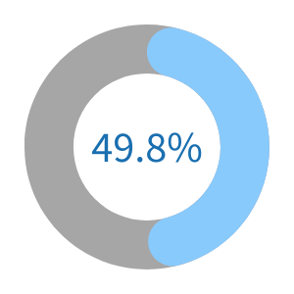
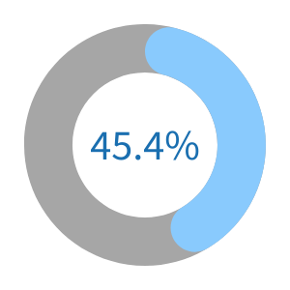
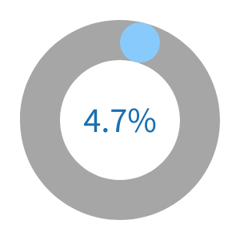
GENERAL TRENDS OF WHITE PLAYERS VS. BLACK PLAYERS:
Average Rating of White Players vs Black Players
White
Black
We can analyze several aspects to understand the trends between White and Black players:
1634.18
1549.24
Win rates for White vs. Black
Win rates for White
Win rates for Black
Draw

Slide 4
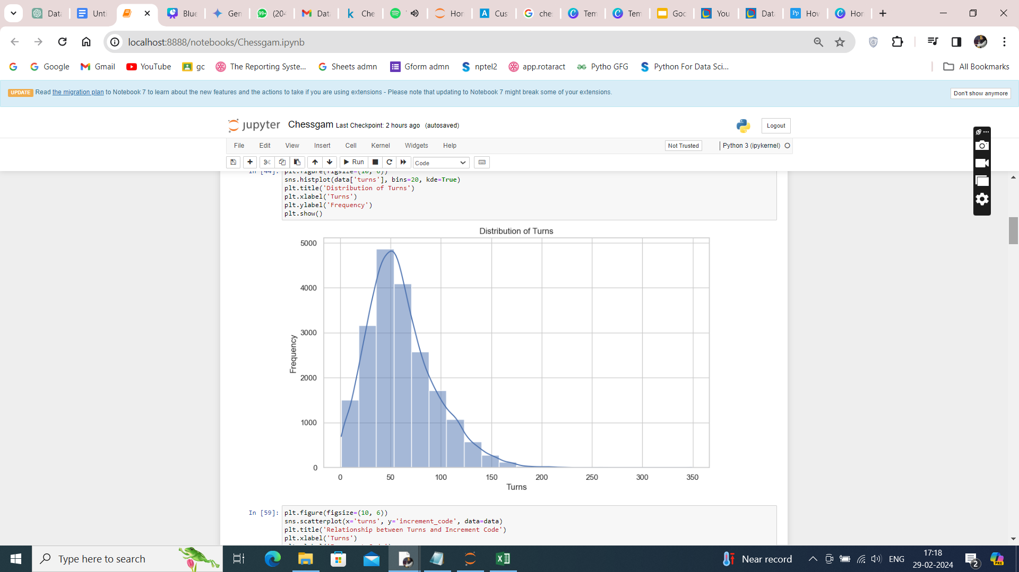
DISTRIBUTION OF TURNS
Visualizing Distributions and Relationships Between Variables : Distribution of turns and Frequency
The Conclusion drawn is that Majority Matches finishes in 50 turns

Slide 5
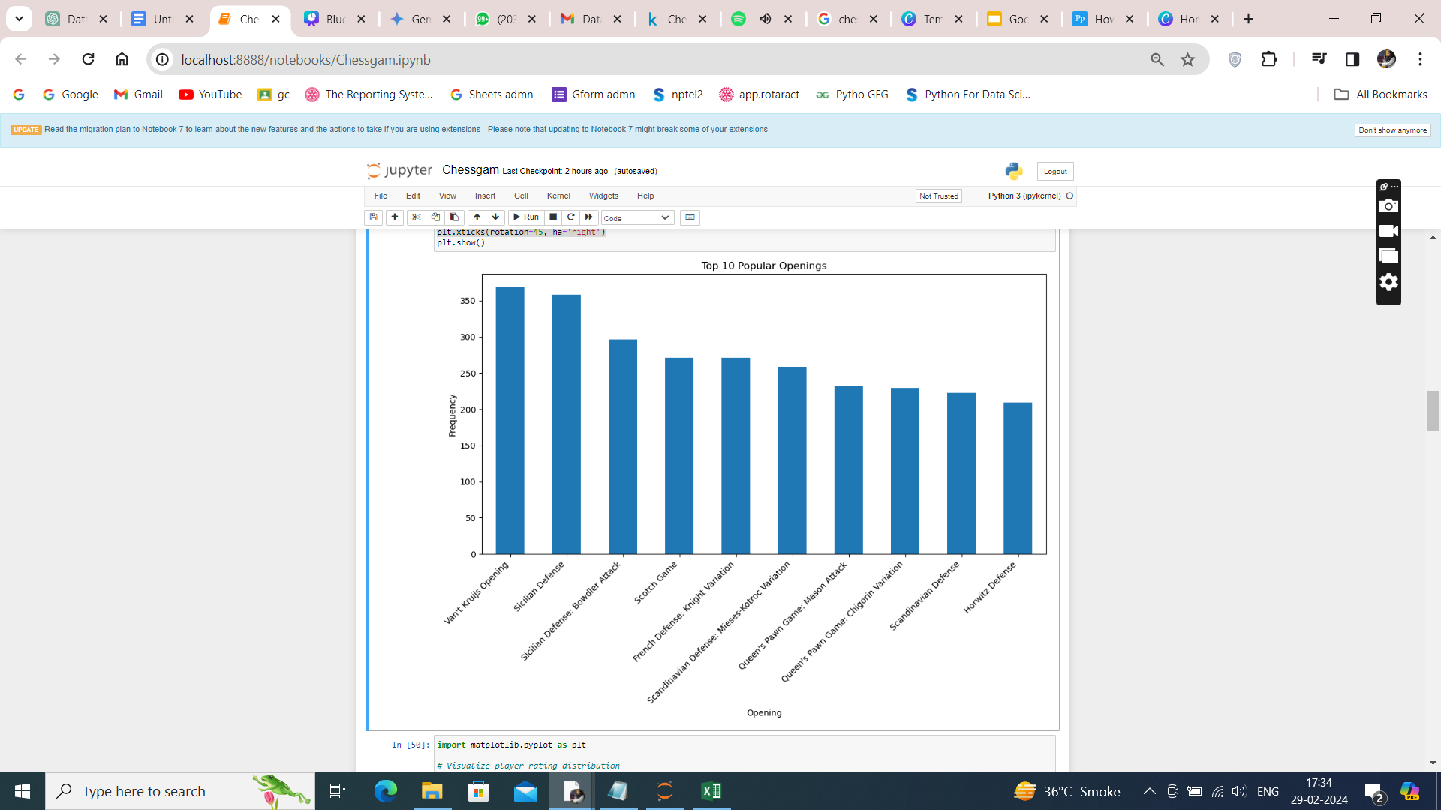
POPULAR OPENING MOVES FOR WHITE VS. BLACK.
The analysis of the dataset revealed intriguing insights into the most frequently used chess openings among players on Lichess. Among the top 10 popular openings, the Van't Kruijs Opening emerged as the most frequent choice. By highlighting the prevalence of the Van't Kruijs Opening, we gain valuable insights into the playing styles and strategic preferences of the players in our dataset.

Slide 6

TOP 10 POPULAR OPENING MOVES WITH FREQUENCY

Slide 7
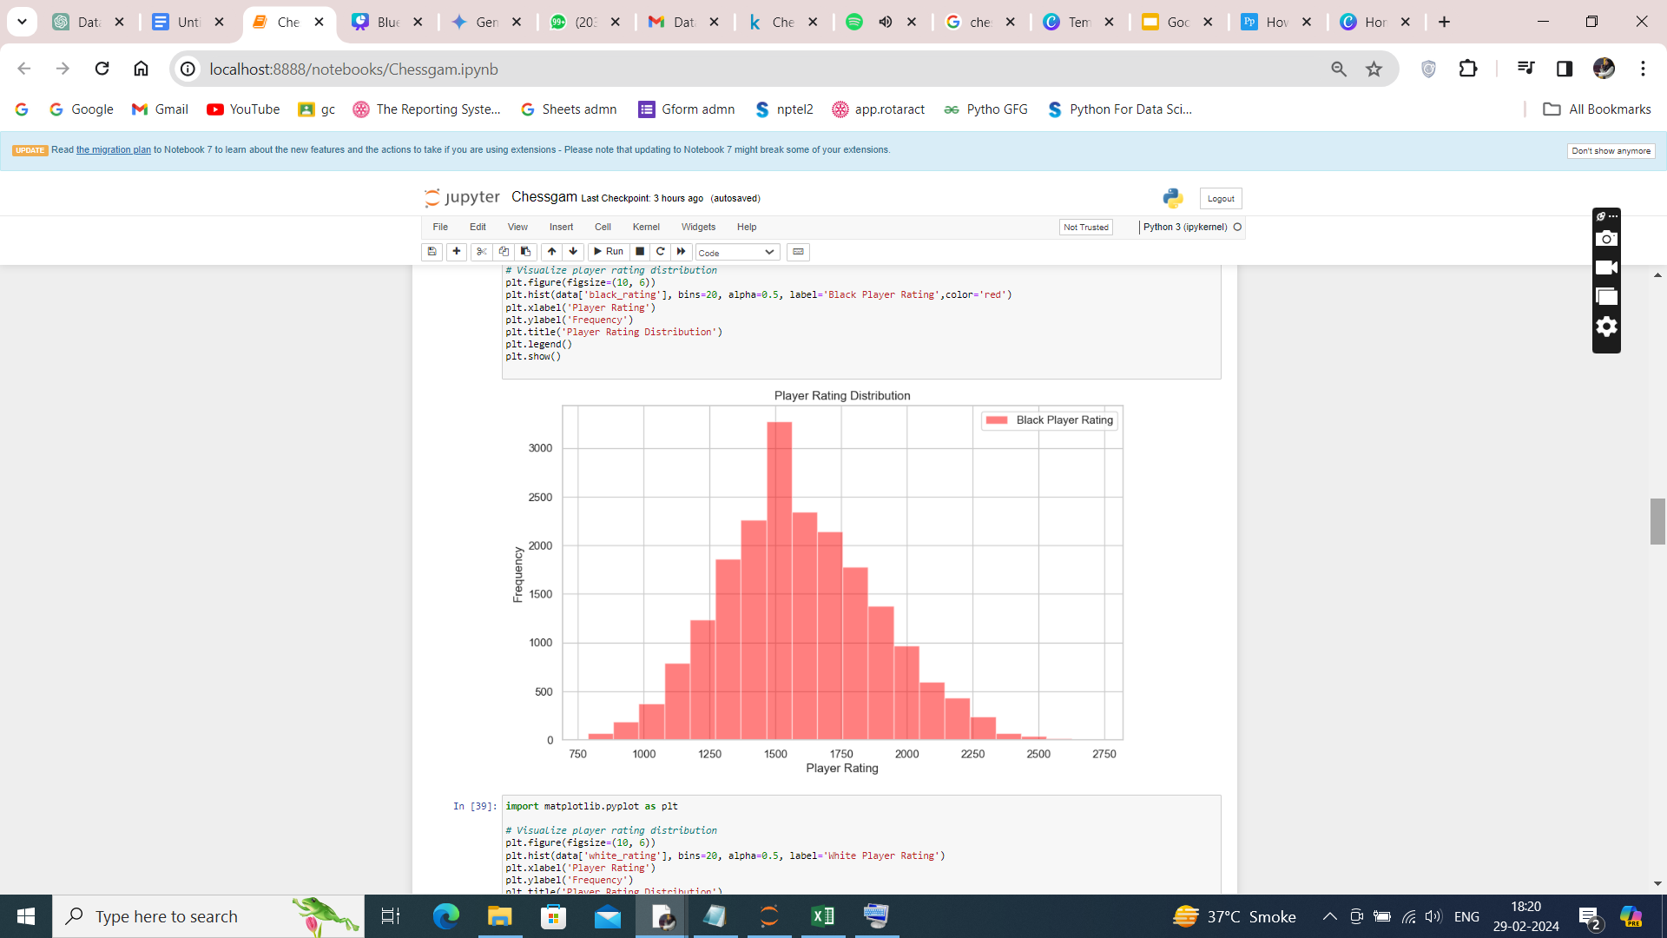
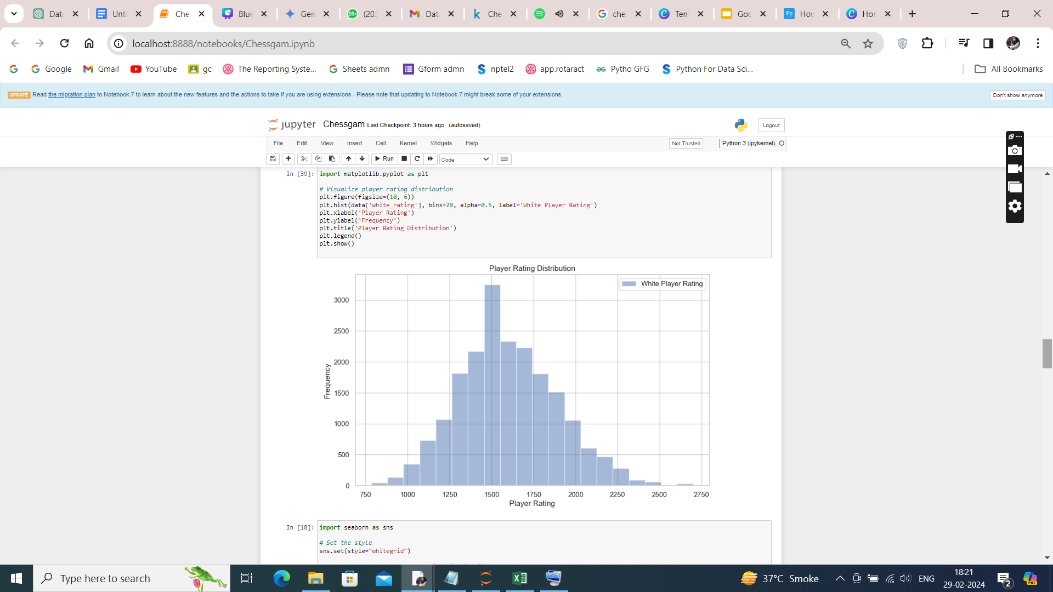
PLAYER RATINGS
Majority (3272) of Black Player Rating was 1500 ± 100
Majority (3246) of White Player Rating was 1500 ± 100

Slide 8
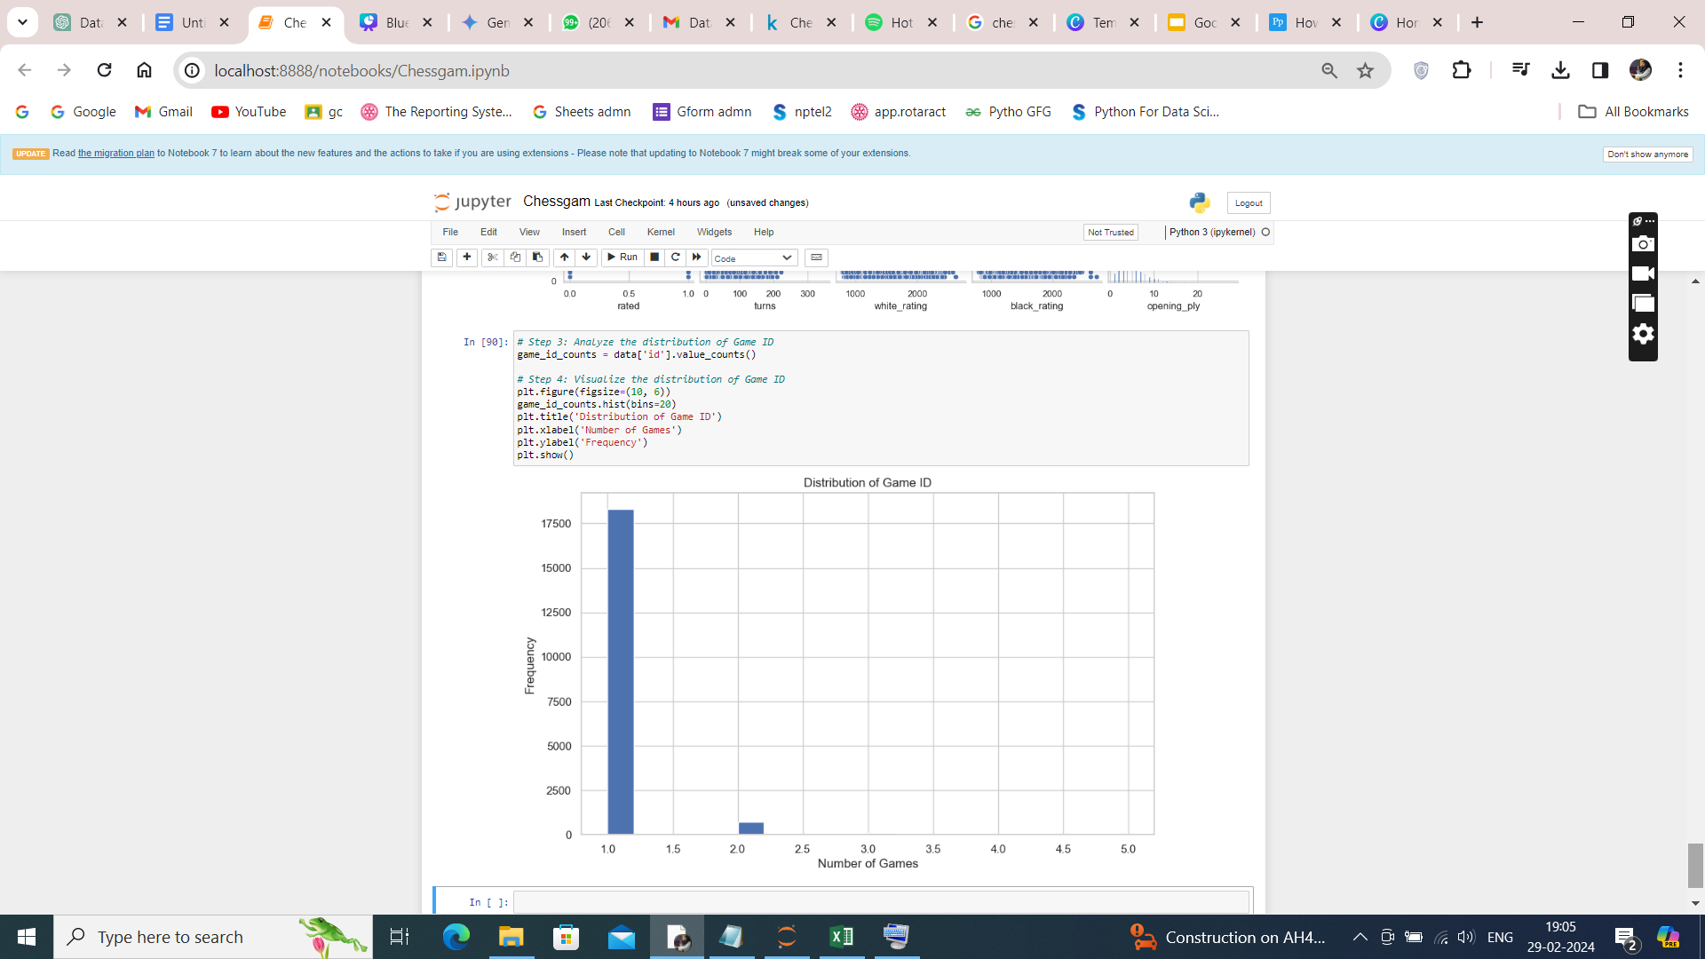
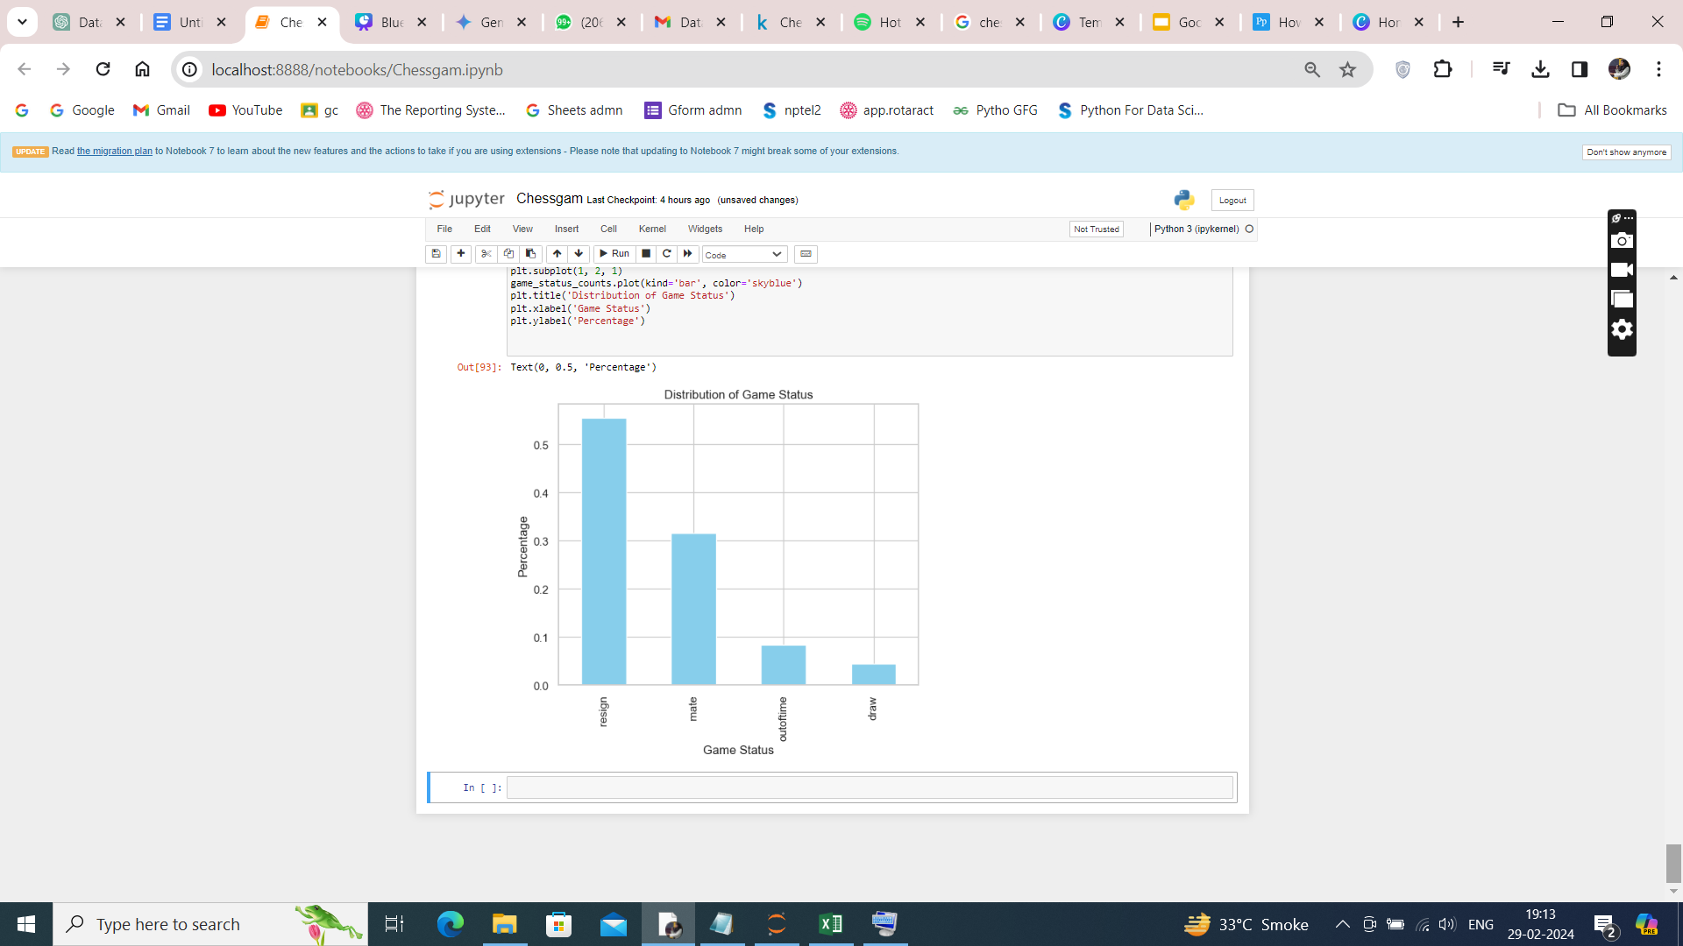
VISUALIZING THE DISTRIBUTION OF GAME ID & GAME STATUS
The Graph depicts and give insights of Number of Games played by the Players in Distribution of Game, 18750 players choose to pay only One game whereas 1250 players play twice
The Graph depicts the statistics of how the game ended

Slide 9
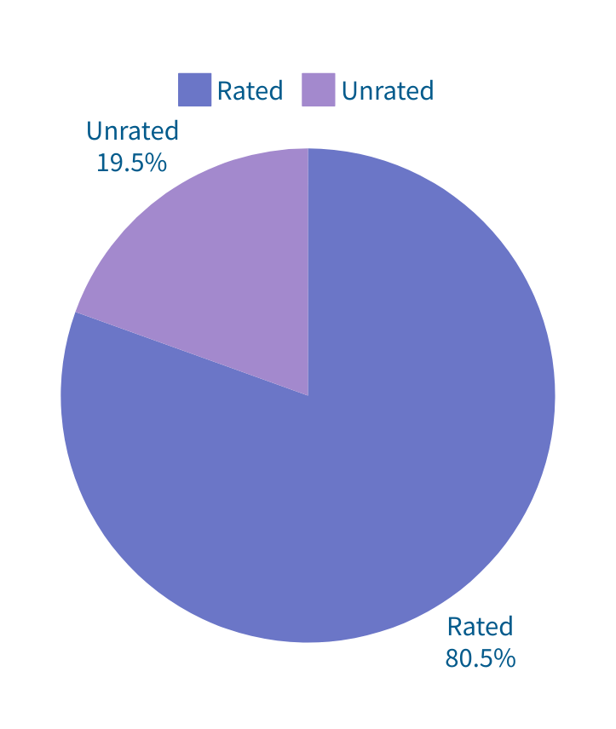
CHART SLIDE REPORT OF RATED & UNRATED
Unrated
19.5% Users prefer Unrated Games
19.5%
Rated
80.5% Users prefer Rated Games
80.5%

Slide 10
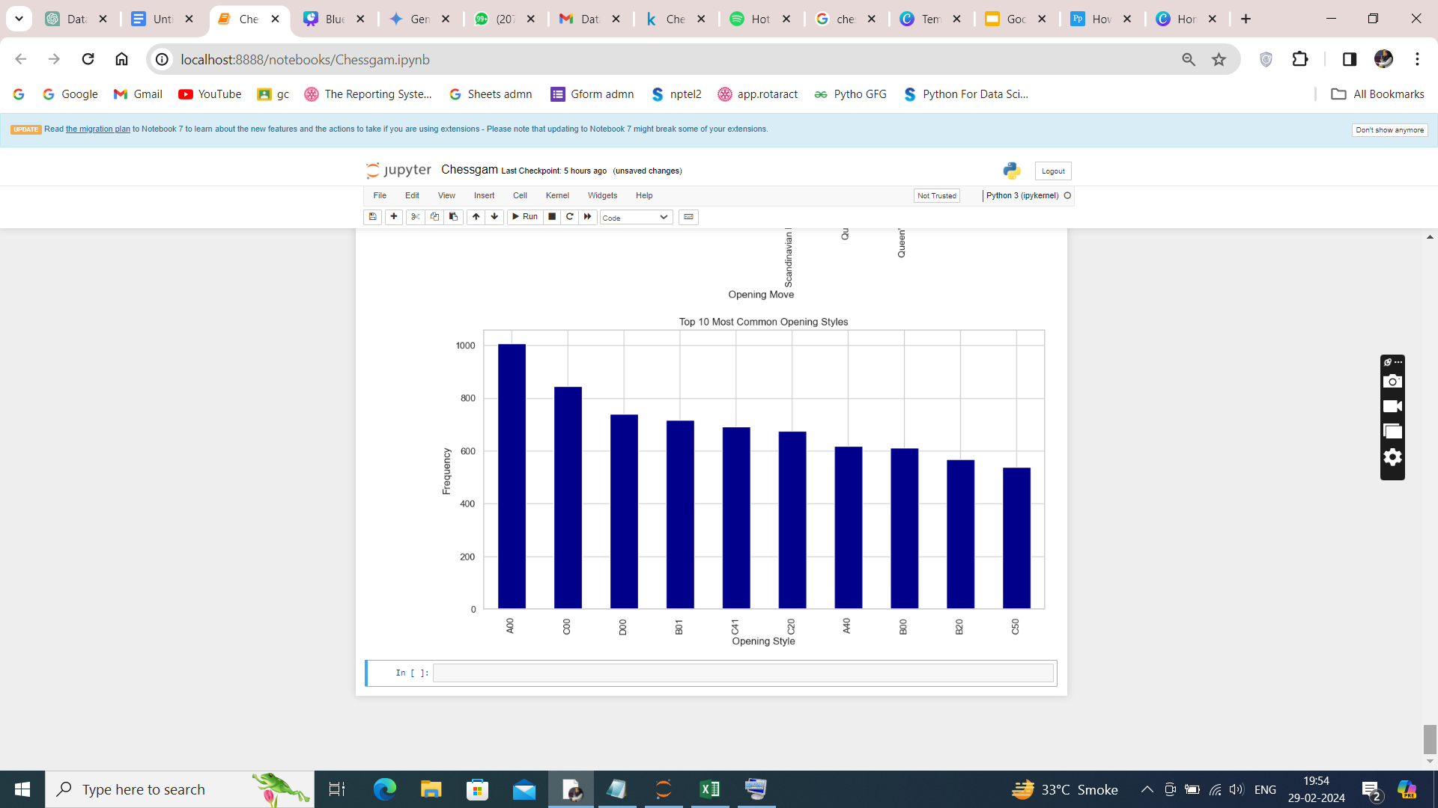
TOP 10 MOST COMMON OPENING STYLES
We can see from the graph that A00 is the most common opening style by the players followed by C00, D00 and so on represented alongside

Slide 11
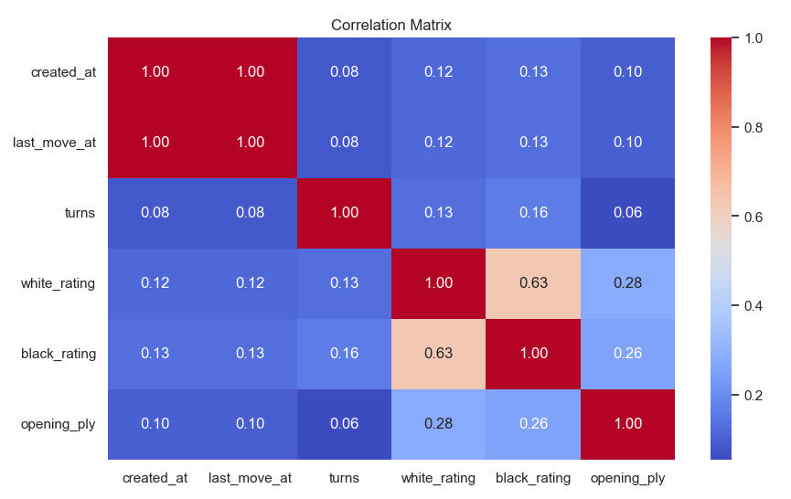
CORRELATION & HEATMAP
Since there is correlation of 1 between created_at
( Start time) and last_move _at (End Time). It depicts that both the values are equal from which we can conclude that there is an error in data set

Slide 12
QUESTION:
Using the opening moves, opening styles, color, and other features, Is it
possible to predict the winner of a match to a certain degree? Explain your answer.
While predicting the winner based on opening features isn't always reliable, it can offer some insights:
Chess engines: They analyze positions and suggest the most likely outcome based on their "knowledge."
Statistical analysis: Studies show certain opening styles might favor one player based on their skill and strategy.
Chess is complex: There are just too many possible moves and positions to guarantee a win from the opening.
Players matter: A skilled player can overcome an "unfavorable" opening with smart tactics.
The game evolves: The opening is just the beginning, and later moves can totally change the course of the game.
So, the answer is yes, but with limitations. Predicting the winner based solely on opening features is not foolproof. The real game is decided by the players' skill, experience, and strategic choices.

Slide 13

THANK YOU

